Slide 1
Farming of the Future:
UAV Systems in Agriculture
Alexandria Horne
Senior Computer Programming Analyst Cincinnati Area Geographic Information System (CAGIS)
Farm Manager, Horne Family Farms
Joshua Murphy
Senior Computer Programming Analyst Cincinnati Area Geographic Information System (CAGIS)
Miami University
May 5, 2016

Slide 2
Presentation Outline
Introduction to CAGIS
Need for Technology in Agriculture
UAV Basics and Use in Agriculture
Challenges/Legalities
Future of UAVs in Agriculture
Employment Outlook
Contact Information

Slide 3
WHAT IS CAGIS?
CINCINNATI
AREA
GEOGRAPHIC
INFORMATION
SYSTEM
ORIGINS:
In 1986, Cincinnati and Hamilton County Government officials recognized the need for greater coordination of services.
CAGIS was then founded as a shared-services organization that provides services and solutions, integrated with land and infrastructure information, to its enterprise members.

Slide 4
CAGIS IS. . . .
Information
A Data Repository or Storehouse
A Service Delivery Platform
A Decision Making
A Management Tool

Slide 5
CAGIS’s Mission is to:
Understand our local business needs
Innovate constantly
Grow our services
And. . . With unyielding integrity, deliver on commitments and set bar high for success.

Slide 6
Organizations Supported by CAGIS
City of Cincinnati Agencies
Transportation & Engineering Planning & Buildings Community Development Public Services Health Parks Fire Police Enterprise Services Law - Real Estate Economic Development Office of the City Manager Office of the Mayor City 911 City Council Members
Hamilton County Agencies
Hamilton County Engineer Planning & Development General Health District Hamilton County 911 Communications Center Emergency Management And Homeland Security Soil And Water Conservation District Hamilton County Auditor Hamilton County Administrator Hamilton County Board of Commissioners Hamilton County Sheriff Hamilton County Prosecutor Board of Elections
Utilities
Greater Cincinnati Water Works Metropolitan Sewer District Storm Water Maintenance Utility Duke Energy Indian Hill Water Hamilton County Storm Water District
Consortium Members
Anderson Township Colerain Township Springfield Township Sycamore Township City of Blue Ash City of Forest Park City of Montgomery City of Norwood Village of Fairfax Village of Indian Hill Village of Lincoln Heights Village of Mariemont Village of Lockland
Non-Profit Members
Cincinnati Public Schools Cincinnati Metropolitan Housing Authority SORTA Xavier University Community Building Institute Hamilton County Development Company Port Authority of Cincinnati Hamilton County Park Board
Private
Inspection Bureau Inc. National Inspection Company. ETC

Slide 7
CAGIS’s Key Applications
Workflow Automation System
Geographic Information System (GIS) Map Information Foundation
Customer Service Response System
Public Access Online Web Applications
Public Safety applications
Construction Coordination System
Pavement Asset Management
Public Safety Applications
Field applications – Inspections, Asset Inventory, mobile GIS
Management Dashboards and reports

Slide 8
GIS Map Information Foundation:
CAGIS manages over 200 map information layers
Topics included in these layers:
Administrative Boundaries
Agriculture
Atmosphere
Biology
Business
Cadastral
Demographic and Public Safety
Elevation
Environment
Facilities
Geology
Health
Imagery and Base Maps
Locations
Organization Business Transaction Support
Rivers, Streams, and other Water Features
Transportation
Utilities

Slide 9
Farming of the Future: UAV Systems in Agriculture
Do we need to change the way we farm?
YES!
Can UAVs help us do that?
YES!

Slide 10
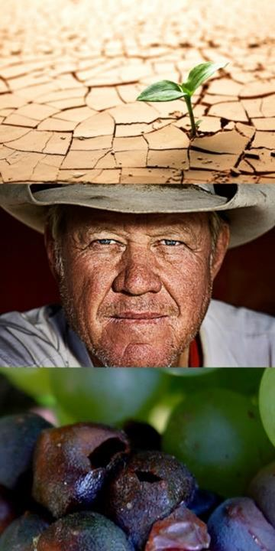

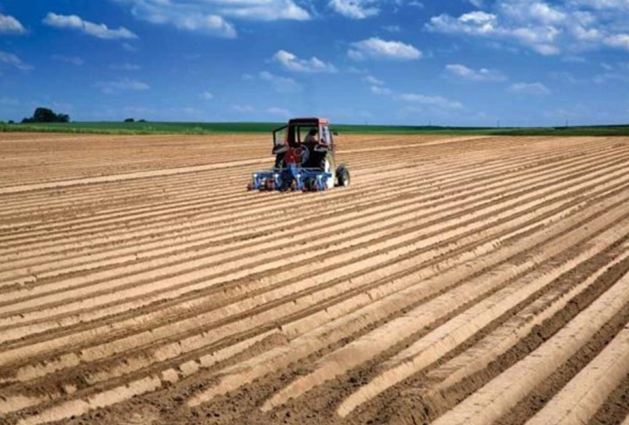
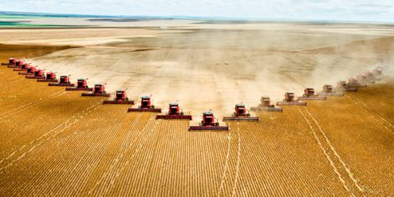
PROBLEMS
Food demand will increase 70% by 2050
Farming is still very inefficient:
Yield per acre can vary 400% within single field
$20B in fertilizer is wasted each year
10-20% yield increase potential in US crops
Diseases cause $33B in crop loss despite $12B spent on pesticides
Notes:
With an exponentially growing world population, the agriculture industry must deliver more food with less water and on less farm land.
Aerial imaging from drones enable a new sophisticated science of farming, called precision agriculture.

Slide 11
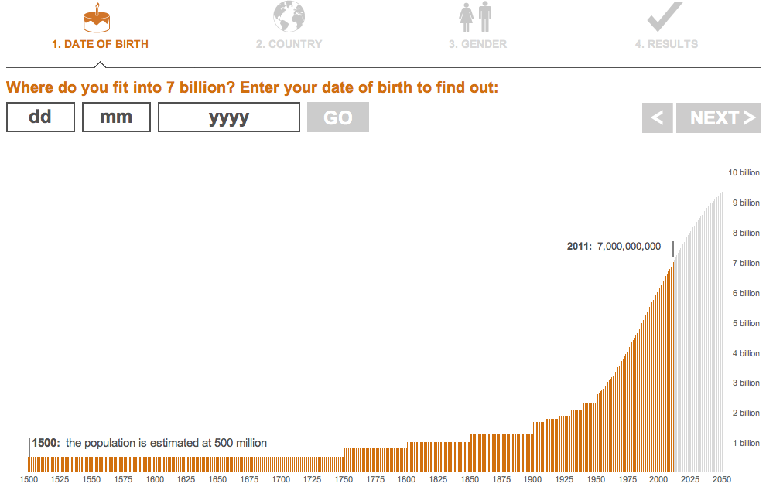
World Population Reaches 7 Billion
October 31, 2011
Projected to Reach 9.3 Billion in 2050
2050 9 Billion
7 Billion
4 Billion
1975
1 Billion
1804
2 Billion
1927
October 31, 2011
Notes:
Red Letter dates:
Population: 7 Billion
Sources:
All population data are based on estimates by the UN Population Division and all calculations provided by the UN Population Fund. The remaining data are from other sections of the UN, the Global Footprint Network and the International Telecommunications Union.
Want to find out more? Visit the UN Population Fund's detailed population calculator, 7 billion and me.
Notes on the data: Only birth dates after 1910 can be accommodated and only countries with populations of more than 100,000 people are included. Where available, the UN's medium variant and average figures from 2005-2010 have been used. World and country population clocks are estimates based on the latest UN figures and growth rates. They may not tally precisely with other clocks because of the way this application is configured.
Three country groupings - developed, developing and least developed - featured in the conclusions are those referenced by the UN for assessing the Millennium Development Goals. The transition countries of Eastern Europe have been grouped with developed nations.

Slide 12
We are destroying our environment
Our misuse of fertilizers, herbicides, pesticides have caused:
Water body “dead zones”
Algae Blooms
Killing off our pollinators (seen any bees lately?)
Monsanto (the Anti-Christ?)
Notes:
With an exponentially growing world population, the agriculture industry must deliver more food with less water and on less farm land.
Aerial imaging from drones enable a new sophisticated science of farming, called precision agriculture.

Slide 13
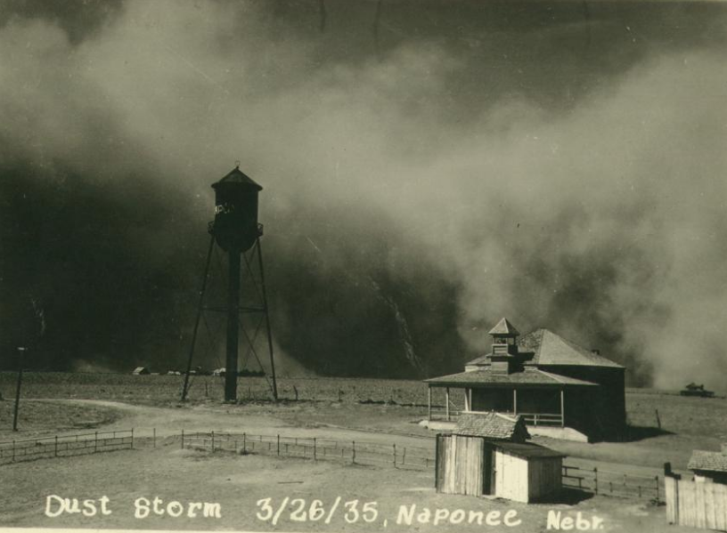
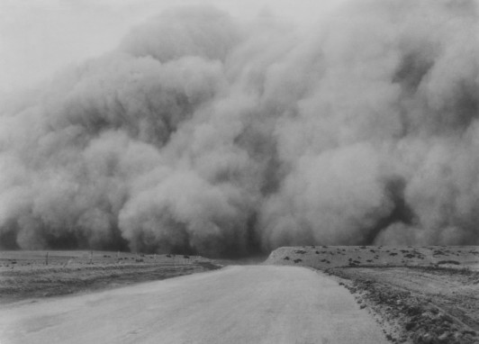

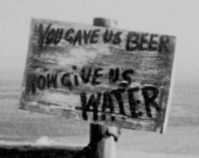
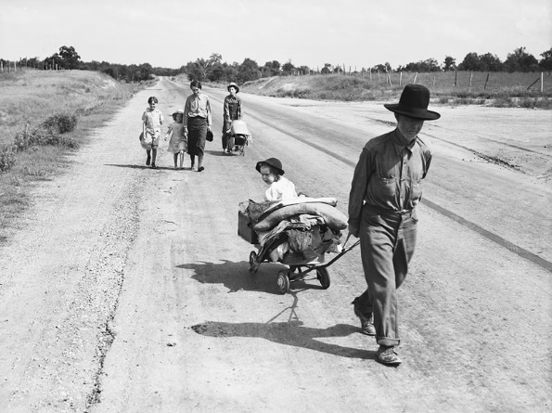
Remember This?

Slide 14
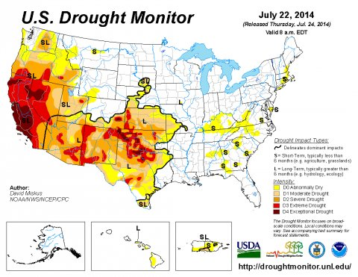

Slide 15
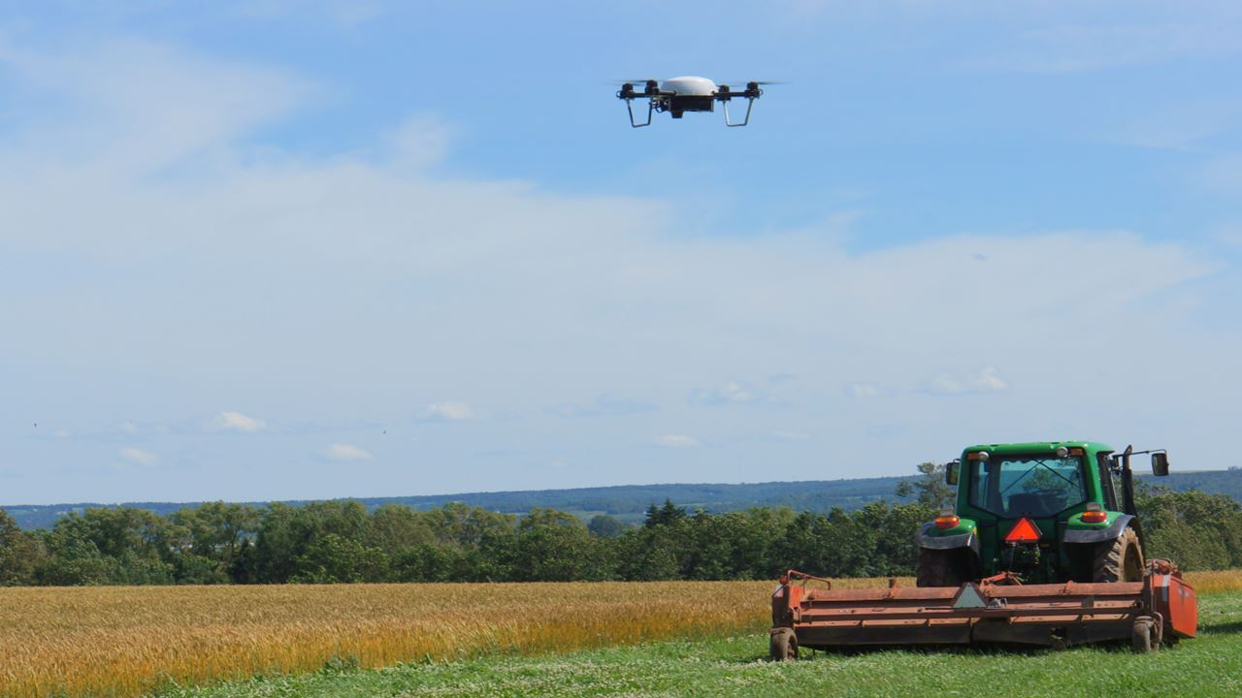
PRECISION AGRICULTURE
By generating detailed insights, farmers can make data-based decisions that will optimize yield and boost revenue while minimizing expenses and the chances of crop failure

Slide 16
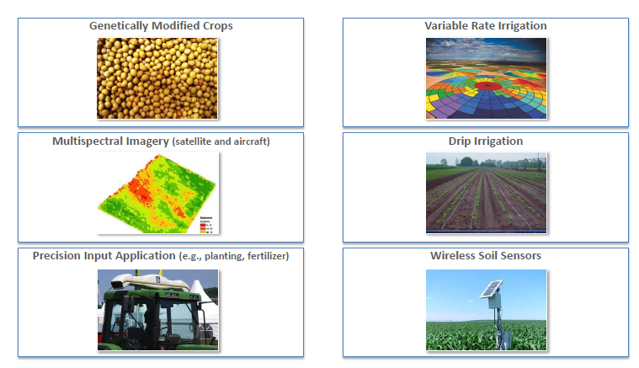
New Data Driven Side of Agriculture
Notes:
Seed Technology - GMO and Hybrid and Heritage
- New varieties adopted to climate change
– Midwest: high heat corn, wheat, soybeans
- CA: wine grape varieties that thrive in heat (Napa becomes too hot)
Wireless soil sensors
Advanced Microspectoral imagery –
- UC Davis Ag Engineering – e-camera that reads moisture content of leaf – plant water needs – time driven throughout the day
- Optimal watering to match plant needs vs reading soil moisture content
Variable rate Irrigation – matched to soil type
Precision Input Application – Prescription Agriculture
- Uses data collected from each pass of equipment through or over field
- Data analytics, uses historical body of data – weather + yield + time variables – CHANGE DECISION MAKING – Reduce Risk
- Monsanto bought Climate Corp
- bottom line: improves yield and profits 7%

Slide 17
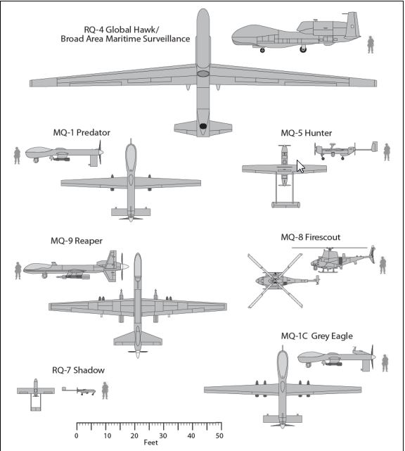
What is an Unmanned Aerial Vehicle (UAV)?
There is nothing unmanned about an unmanned vehicle!
What are they called:
Unmanned Aircraft System (UAS) (FAA and Congress)
Unmanned Aerial Vehicle (UAV)
Remotely Piloted Aircraft Systems (RPAS) (ICAO and Air Force)
Drones
UAV Classification by Size
*Source: : Congressional Budget Office, Policy Options for Unmanned Aircraft Systems, Publication 4083, Washington, DC, June 2011

Slide 18
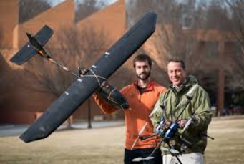
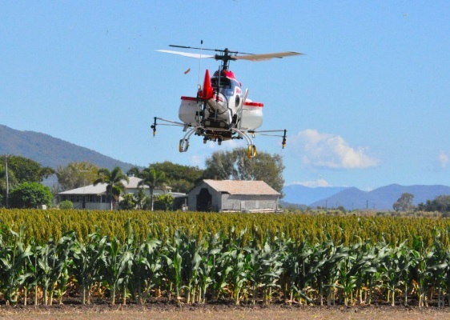
The drone market is estimated to be an $8 billion market and agriculture is projected to be 80% of the total market
The agriculture drone market includes: equipment, autopilot software, post-processing software, cloud processing and cloud storage
Two basic types of unmanned aerial vehicle (UAV) are used: rotorcraft and fixed wing
Fixed wing aircraft cover more area in a single flight, but do not VTOL capabilities and carry smaller payload. Typical flight is 40-50 minutes.
Rotorcraft have vertical takeoff and landing (VTOL) capabilities and the ability to fly very slowly or hover making them very desirable for most applications. Battery life is limited to 20-30 minutes, limiting mission times

Slide 19
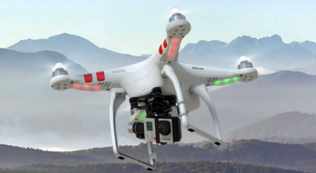
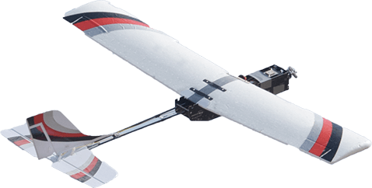
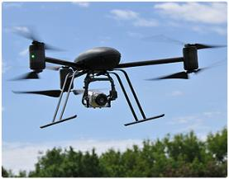
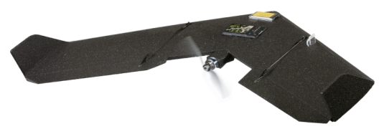
UAV Pricing
Rotary
Fixed Wing
DJI Phantom
< $1000
Precision Hawk $9,000
http://www.dji.com/product/phantom-2/
http://www.precisionhawk.com/
DraganFly X6
Swinglet CAM $10,500
$36,000.00
http://www.sensefly.com
http://www.draganfly.com

Slide 20
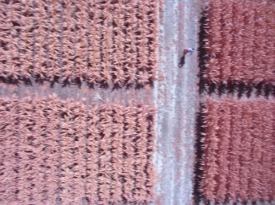
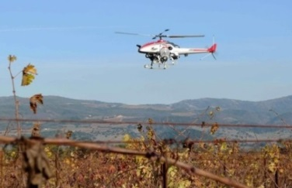
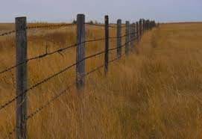
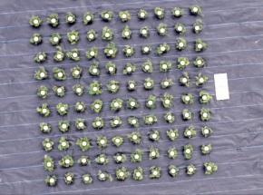
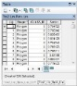
How are UAVs being used in a agriculture?
Crop monitoring
Chemical applications
Land & building management
Crop & livestock inventory management

Slide 21
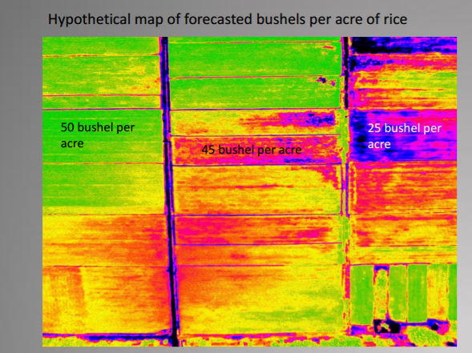
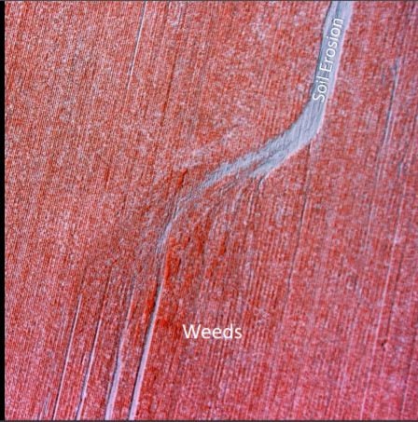
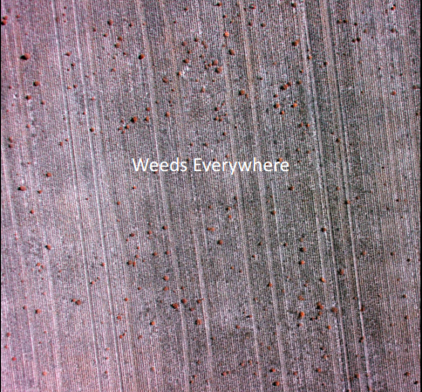
Crop monitoring (nutrients, water, pests)

Slide 22

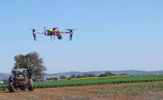
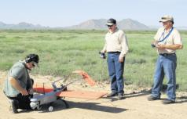
UAVs and Precision Agriculture
Precision agriculture totals approximately 80% of the potential commercial market for UAVs
UAV in agriculture has the potential to have an $11 billion economic impact in the first three years following integration. Almost $66 billion over 11 years.
“Precision application, a practice especially useful for crop farmers and horticulturists, utilizes effective and efficient spray techniques to more selectively cover plants and fields. This allows farmers to provide only the needed pesticide or nutrient to each plant, reducing the total amount sprayed, and thus saving money and reducing environmental impacts.”
Source: Michael Toscano, President and CEO, AUVSI

Slide 23
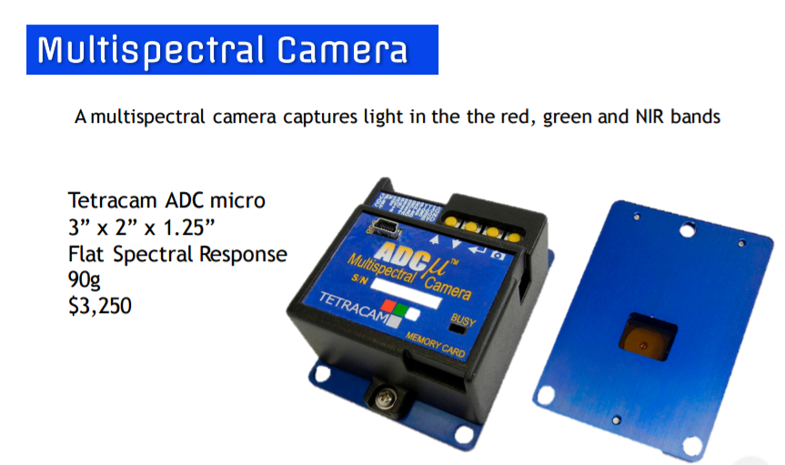
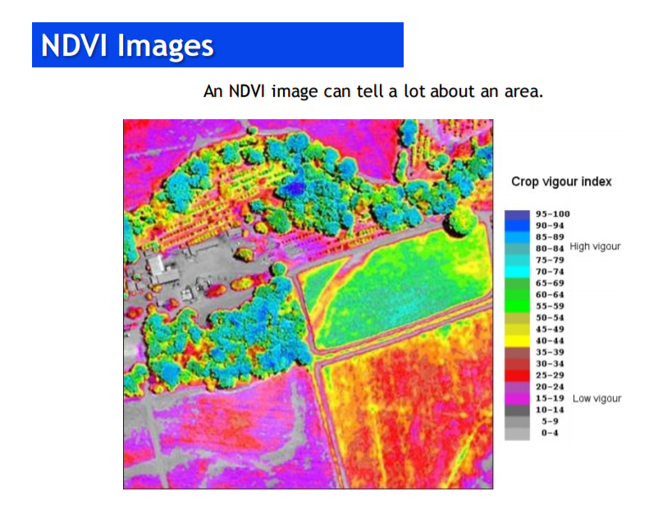

Slide 24
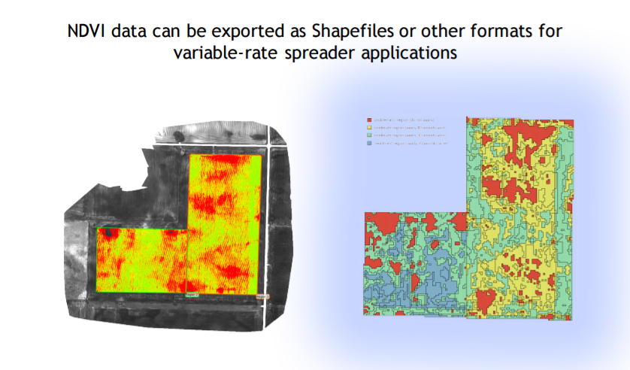

Slide 25
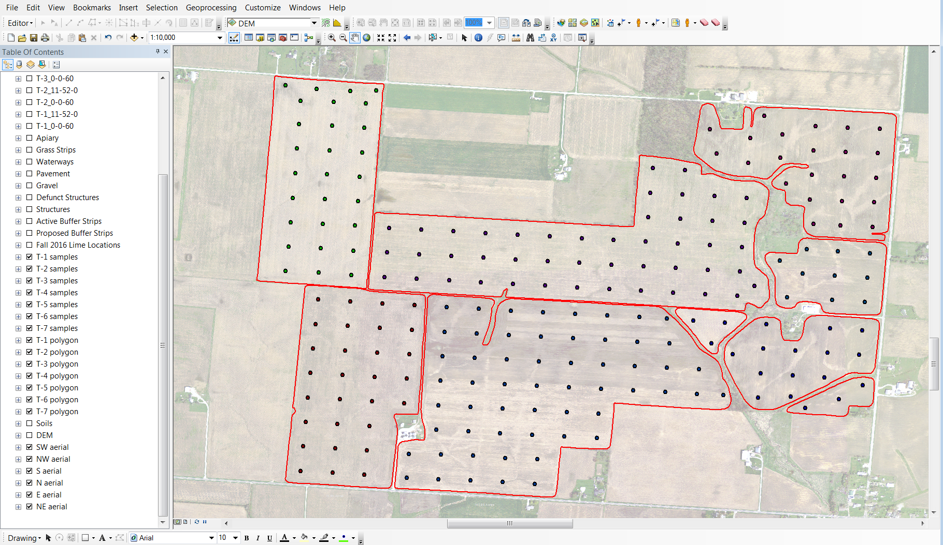
Soil Sample Grid Map

Slide 26
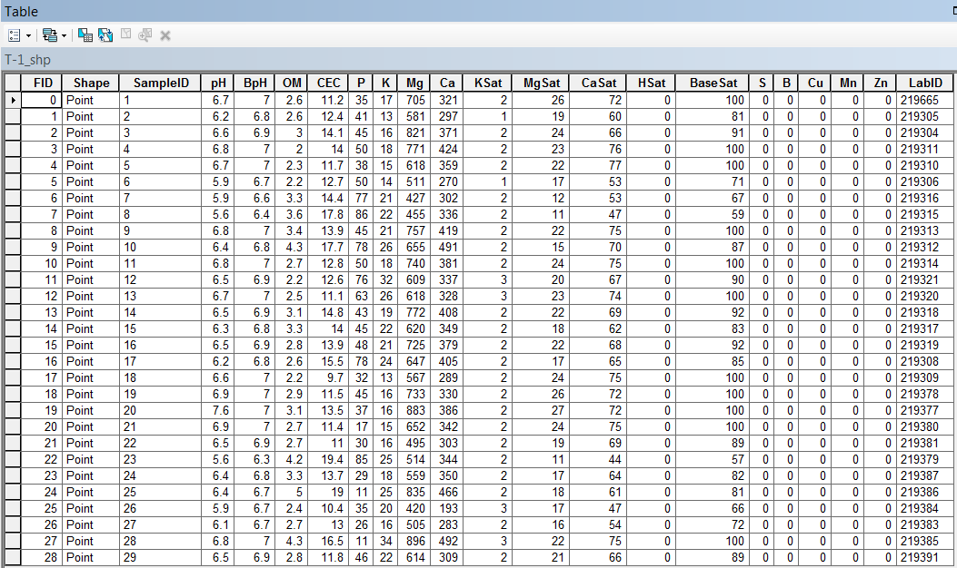
Soil Sample Results

Slide 27
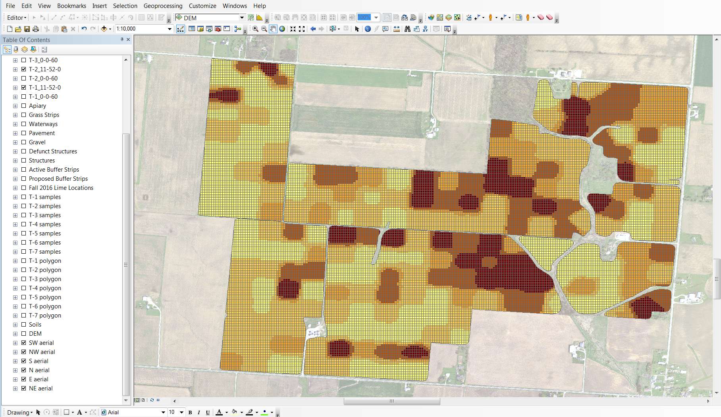
Phosphorous Prescription Map

Slide 28
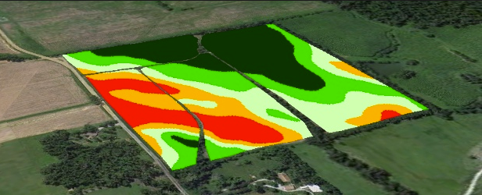
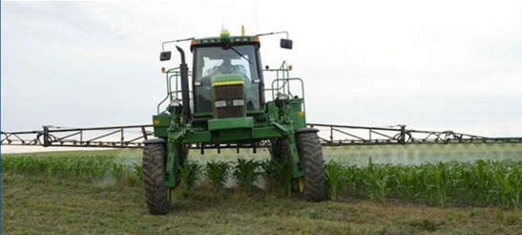
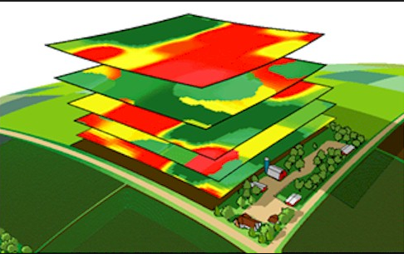
Variable Rate Technology (VRT)

Slide 29
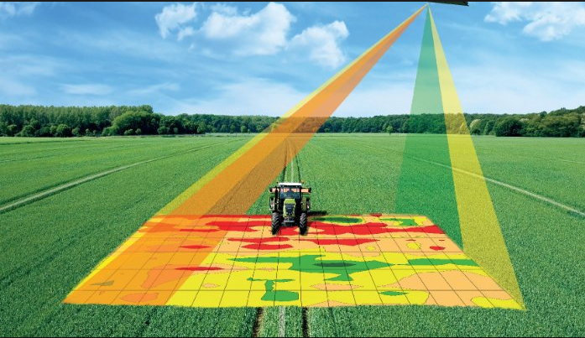
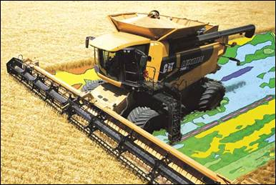
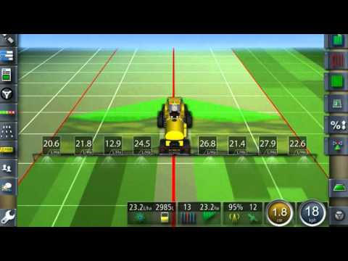
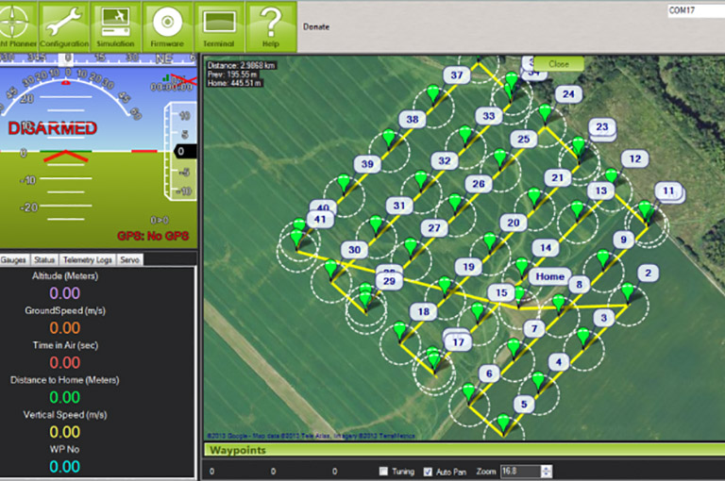

Slide 30
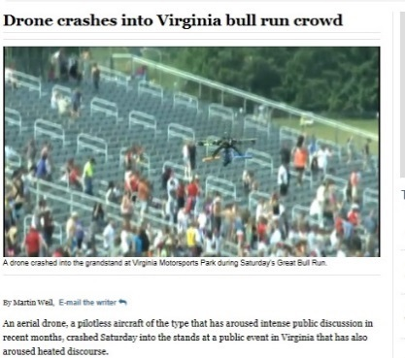
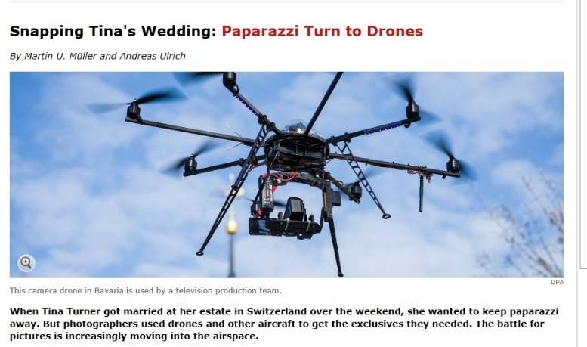
Challenges to Widespread Adoption
Safety
Privacy
Extend battery life (stay aloft for 5-15 minutes - limited ground coverage)
Variety of UAV types (semi-autonomous, hand launched etc.)
Research data on reliability is missing (500 hrs, 1000 hrs etc. useful life)
Weather robust
Missing data network to download images and videos from multiple UAVs
Minimize solar flare impact on navigation
“ The challenge for industry is that the public perception of this technology is being shaped by one percent of its [potential] use.”
- Peter W. Singer, Director for 21st Century Security and Intelligence, Brookings Institute

Slide 31
UAV technology is moving ahead at a faster pace than regulations
It is currently ILLEGAL to fly drones for commercial applications.
While the FAA has been slow to enforce these laws, the fact remains that commercial operators need an FAA 333 exemption to operate legally and carry adequate insurance.
Currently the FAA is issuing exemptions for companies that meet their flight qualifications. Some of the requirements are: • Must have a pilot in command (PIC) with current pilot’s license, valid medical • Cannot fly above 400 ft • Flight plans will need to filed prior to all flights • VFR conditions only (line of sight only )
The future of drones in agriculture is AUTOMATION. Several challenges need to be overcome for fully or even partially automating the process.
• Flight Planning
• Flying autonomous flights, changing/recharging batteries
• Upload images to 3rd for processing
• NDVI processing
• Technical issues, flying and maintenance

Slide 32
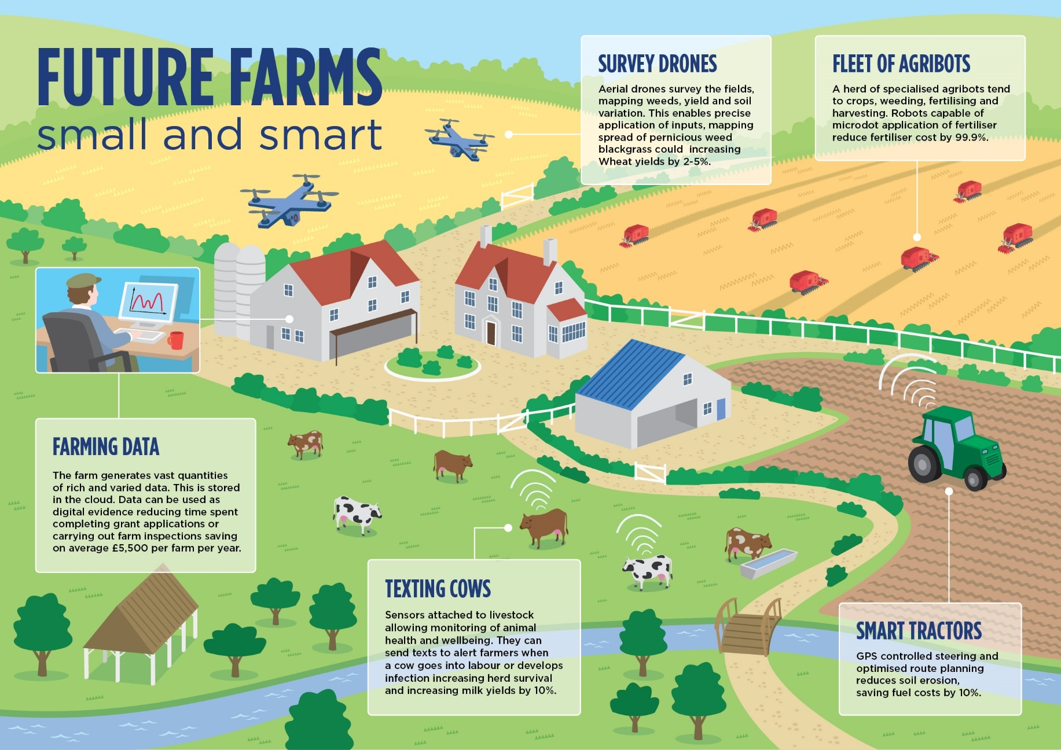

Slide 33
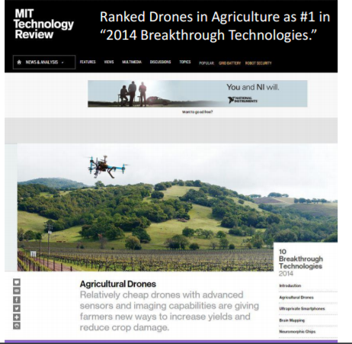
Employment Outlook
There are 10 times more UAS applications in agriculture than any other area 80% of the economic impacts of UAS will be in agriculture.

Slide 34
GIS Employers
Local, state and federal government
Military (Wright-Patterson AFB)
Universities
Non-profits
Agriculture
Private Sector:
Trimble (Office in Dayton, Ohio)
Leidos (Office in Dayton, Ohio)
Woolpert (Headquarters in Dayton, Ohio)
GIS Jobs Clearinghouse
http://www.gjc.org/

Slide 35
Conclusion
UAV technology is moving ahead at a faster pace than regulations
Precision agricultural is expected to be the largest beneficiary
FAA’s regulations are eagerly awaited
Exciting times lay ahead

Slide 36
Thank you for your time!
Are there any questions?
Alexandria Horne
alexandria.horne@cincinnati-oh.gov
Joshua Murphy
Joshua.murphy@cincinnati-oh.gov

